Slide 1
COVID-19 and your business and how CTR CAN HELP

Slide 2
COVID-19 and your business webinar
Some Housekeeping Items:
All participants have been placed on mute.
All registrants will receive a follow up e-mail with a link to the recorded webinar and any training documentation.
Don’t forget to check out our Events Calendar on our website to register for upcoming trainings and webinars at https://ctrhcm.com/events/
This training is intended for educational and informational purposes. We hope that you will learn a lot today but the information should not be construed as legal advice.
If you have any questions or want to request training, please e-mail training@ctrhcm.com

Slide 3
COVID-19 and your business webinar
Today’s Presenters:
BOB FLOREAK
President, Acuity HR
KARA STIVASON
Trainer, CTR

Slide 4
AGENDA
Origin of COVID-19 & Symptoms
Latest Legislative Updates
Layoffs-what to consider
FAQs & how CTR can help support you

Slide 5
PURPOSE
Provide you with an overview of information and resources regarding the impact of COVID-19 in your workplace
Review recent guidance provided by the CDC, EEOC and other agencies
Discuss the basics of the Families First Coronavirus Response Act (FFCRA)
Review some of the considerations for furloughs or layoffs in your organization
©2020 – Acuity Human Resources, LLC
Notes:
Laura – based on the questions we are receiving, modifying continually

Slide 6
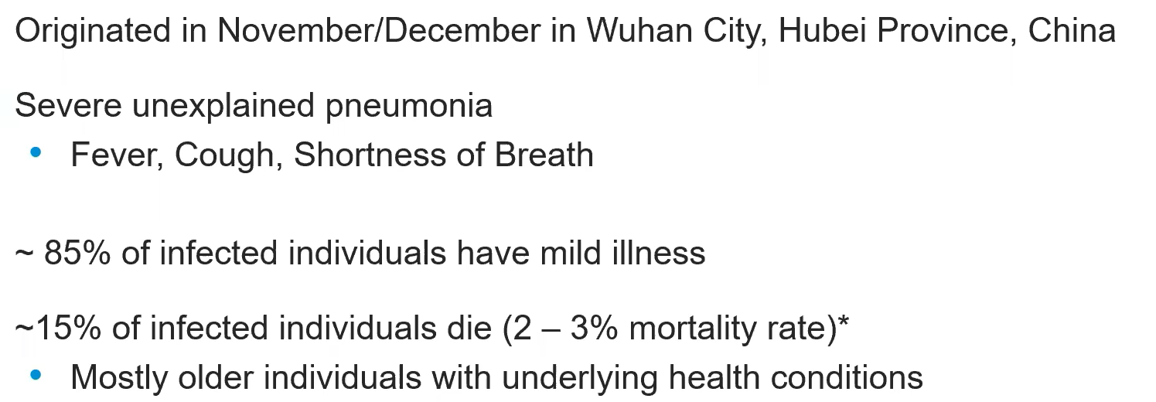
Origin of covid-19 & symptoms

Slide 7
CDC GUIDANCE
The CDC has not issued recent guidance for COVID-19
The most recent update was March 8, 2020 and can be accessed at:
https://www.cdc.gov/coronavirus/2019-ncov/community/guidance-business-response.html
Notes:
Laura – this is one thing we will not provide as pdf as it continues to change and be updated

Slide 8
CDC GUIDANCE
Encourage sick employees to stay home, as well as employees who have sick family members
Do not require a doctor’s note for employees that are sick due to lack of access to primary care
Communicate good hygiene habits and requirements in your work location including mandatory handwashing and social distancing
Perform routine environmental cleaning and provide cleaning supplies
Notes:
Laura – doctors note. Caring for sick family members may soon be covered by the Families First Coronavirus Response Act currently a bill before senate.. Clients in Manufacturing, direct support, healthcare, etc. that may have points-based or more rigid attendance policies, let’s discuss temporary loosening that can still be applied in a consistent manner. Great most of time, but don’t want to create something so strict that sick people come to work. Provide breaks for hygiene.

Slide 9
CDC GUIDANCE
Ensure that managers in satellite locations understand your company’s approach to COVID-19
Plan to minimize exposure between employees and review necessity and structure of meetings; consider shift staggering and flexible work hours for employees who must be in the office
Stop all discretionary travel, meetings or other interaction
The CDC guidelines are available online and you are encouraged to check regularly for updates
Notes:
Laura – we will talk later about contingency plan development.

Slide 10
EEOC GUIDANCE
EEOC issued updated guidance on the ADA, the Rehabilitation Act, and COVID-19 on March 19, 2020
ADA and Rehabilitation Act still apply but they do not interfere with the CDC Guidelines
For EEOC Pandemic information go to: https://www.eeoc.gov/facts/pandemic_flu.html
Health issues are sensitive, and its important to make sure managers understand the do’s and don’ts of conversations and inquiries around Covid-19
Notes:
Laura – compliance with employment laws. EEOC, HIPAA, FLSA

Slide 11
EEOC GUIDANCE FAQS
Can you send an employee home if they exhibit symptoms during a pandemic?
During a pandemic, how much information may an employer request from an employee?
During a pandemic, can we take temperatures?
When employees return from travel, can the employer ask about exposure to pandemic?
During a pandemic, can an employer ask why an employee was absent from work if the employer suspects it was for medical reasons?
Notes:
Laura – this is a resource that will be shared. EEOC document still refers to H1N1 but hopefully will be updated asap

Slide 12
OSHA GUIDELINES
OSHA Recently released guidelines can be found at: https://www.osha.gov/SLTC/covid-19/
Designate an area for people to go to if they feel ill
Provide training on protective clothing, sanitation methods, etc
Understand the risk exposure for each of your job classifications and develop a plan to address
Notes:
Laura – keep in mind who the recipient is – if being requested by federal, state or government agency, may share
Share minimal amount of personal information, which may be context specific, where the individual may have come into contact with the employee, etc.
Avoid sharing name and any unnecessary personal information

Slide 13
The Families First Coronavirus Response Act
The Families First Coronavirus Response Act (H.R. 6201) (the “Bill”), was signed by the President on March 18, 2020
The effective date is somewhat confusing but it appears to be April 2, 2020 and is to expire on December 31, 2020
The language in the Act is brief and few details for regulations and administrative guidance are currently available
Many attorneys are recommending patience at this time and not to communicate procedures to employees until more details are available
Notes:
Bob
Emergency Paid Sick Leave
The emergency paid-leave provisions require employers to provide paid sick time for the following reasons:
To enable an employee to self-isolate due to the employee’s coronavirus diagnosis;
To enable an employee experiencing symptoms to obtain a medical diagnosis or care;
Because a public-health official or a health-care provider has recommended or ordered the employee to remain out of work because the employee or the employee’s family member has been diagnosed or is exhibiting symptoms;
To enable the employee to care for or assist a family member who has been diagnosed or is exhibiting symptoms;
To enable the employee to care for his or her child if, because of the coronavirus, the school or daycare has been closed or the child-care provider is unavailable.
Expanded FMLA Coverage
The Bill also provides for a significant expansion of FMLA coverage for coronavirus-related reasons, including paid leave after 14 days of unpaid leave. Employers would be required to pay eligible employees up to two-thirds of the employee’s regular pay but could seek to mitigate those costs using the tax credit provided for in the Bill.

Slide 14
WHAT WE DO KNOW
Emergency Paid Sick Leave is available under the Act
Family and Medical Leave has been expanded and redefined under the Act
Tax Credits to employers will be used to fund benefits under the Act
There is funding for additional Unemployment Compensation by the Federal Government
Notes:
Laura

Slide 15
THE EMERGENCY PAID SICK LEAVE ACT
Under the Act, employers with less than 500 employees are required to provide 80 hours of paid sick time for full-time employees who are unable to work, or telework
Part-time employees are eligible for the average number of hours worked in a two-week period
The bill will provide relief for several reasons, including:
If the employee has been ordered by the government to quarantine or isolate or has been advised by a health care provider to self-quarantine because of COVID-19
If they have symptoms of COVID-19 and are seeking a medical diagnosis
If they are caring for a relative who is in quarantine or isolation
If their child's school or child care service is closed because of the public health emergency.
Notes:
Laura

Slide 16
THE EMERGENCY PAID SICK LEAVE ACT
There is no eligibility or waiting periods for sick time eligibility
Paid sick time is calculated using the employee’s regular rate of pay not to exceed $511/day or $5,110 in aggregate when used in conjunction with an official isolation order, doctor’s recommendation for self-quarantine, or employee is experiencing symptoms and is seeking a medical diagnosis
Paid sick time is calculated using the employee’s regular rate of pay not to exceed $200/day or $2,000 in aggregate when used in response to caring for an individual of caring for child when no child care is available
Employers MAY NOT require an employee to substitute other paid sick time provided by the employer
Exemptions, as with expanded FMLA may be available
Notes:
Laura

Slide 17
EMERGENCY FAMILY AND MEDICAL LEAVE EXPANSION ACT
Covers employers with less than 500 employees, including small employers
Employers with less than 50 employees may seek exemption from coverage if the requirements of the Act “would jeopardize the viability of the business as a going concern”. Additionally, there are specific exclusions for some healthcare workers
The bill provides 12 weeks of job-protected coverage for employees that have been with the company for at least 30 days. There is limited reinstatement rights for employers with less than 25 employees
Reasons for eligibility include the inability to work, or telework due to school closures or lack of day care for employees with a child under the age of 18
Pay will be capped at $200 a day (or $10,000 total)
Notes:
Laura

Slide 18
EMERGENCY FAMILY AND MEDICAL LEAVE EXPANSION ACT
Under the Act, the first 10 days are unpaid, but for the next 10 weeks, eligible employees (those who have been employed with the employer for at least 30 calendar days) will receive two-thirds pay while on leave
The calculation for 2/3 pay is regular rate of pay and the number of hours the employee would otherwise be scheduled to work. For variable scheduling, there is a 6 month look back
Employees can elect to use accrued sick or personal time during the first 10 days but the employer may not require it
Employer’s are eligible for tax credits for the employer’s share of social security to offset the expense
Notes:
Laura

Slide 19
BUSINESS OPERATIONS
Your organization may need to implement layoffs or furloughs
You will need to create documentation and processes for notifications, benefits administration, etc
Consider your benefits plan for employees during layoff and contact your benefits broker for assistance with compliance
Have an ongoing communication plan with all employees, active and furloughed
Create policies for work-from-home employees
Engage managers in developing employee engagement plans
Can you use this time to work on your business
Notes:
Laura

Slide 20
NEXT STEPS
A relief bill for small business in being discussed in the Senate
Assess your own business situation and develop your action plan
We expect to get more specific guidance very soon
If you have an emergency situation, consult your employment attorney for advice
Start to develop processes and procedures for the administration layoffs and the provision under the newly enacted legislation
CTR and Acuity Human Resources are working together to provide resources to assist you with these difficult times
Notes:
Bob

Slide 22
Do you have employees still receiving paper checks?
Moving employees to direct deposit or PayCards can help to alleviate the need for an employee to have to physically come into your office.
Don’t have PayCards? We can help with that. Rapid! PayCard is a benefit that you can provide your employees at NO cost to you. It works just like direct deposit, but the funds are deposited to the PayCard instead of a paper check each pay period.

Slide 23
Are your employees still receiving pay stubs?
We can turn on Employee Self Service for employees to view pay stubs online.

Slide 24
Unsure of your state’s requirements around direct deposits and pay stub?
Please view these documents:
Paystub Requirements by State
Paycard Laws by State
Direct Deposit Laws by State
Moving ESS to Electronic Paystubs

Slide 25
Need employees to be able to clock in and out remotely instead of paper timesheets?
We have iSolved Time – A built-in, robust Time & Attendance solution. All of your tracking needs can be managed right within iSolved and employees can clock in on their computer or through the mobile app.
iSolved Time

Slide 26
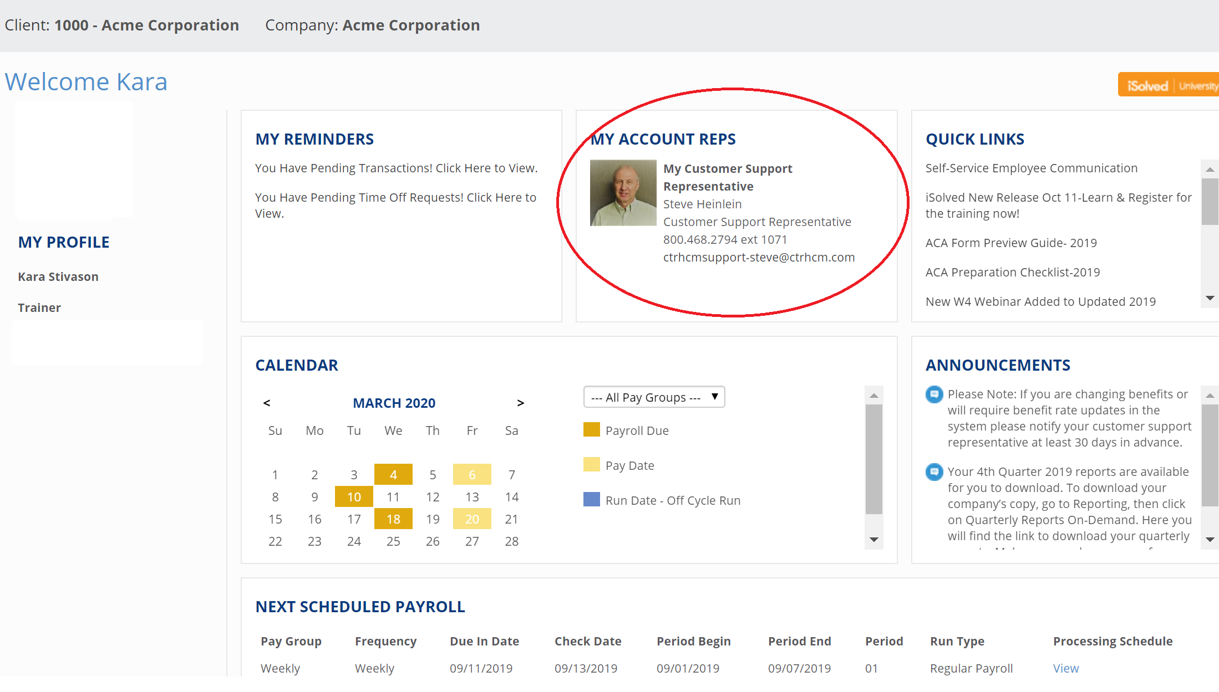
FAQS
Q: If we are laying off an employee, how do I enter the data in iSolved?
A: Depending on your intention with continuing benefits, we can help you enter this data in iSolved so you can maintain accurate data. (For example, we can build unique status codes and walk you through what to look for.)
CONTACT YOUR SUPPORT REP: You can find your support rep on the Client Landing Page in iSolved

Slide 27
FAQS
Q: If we are considering setting up new paid/unpaid sick leave accrual plans, how do I do that?
A: Good news. We are prepared to help you with this. Our team has been busy building and testing accrual policies and earning codes in our demo environment. We have specific accrual policies in place along with specific earning codes so that we can help you track and report on this information.
Let’s dive deeper…

Slide 28
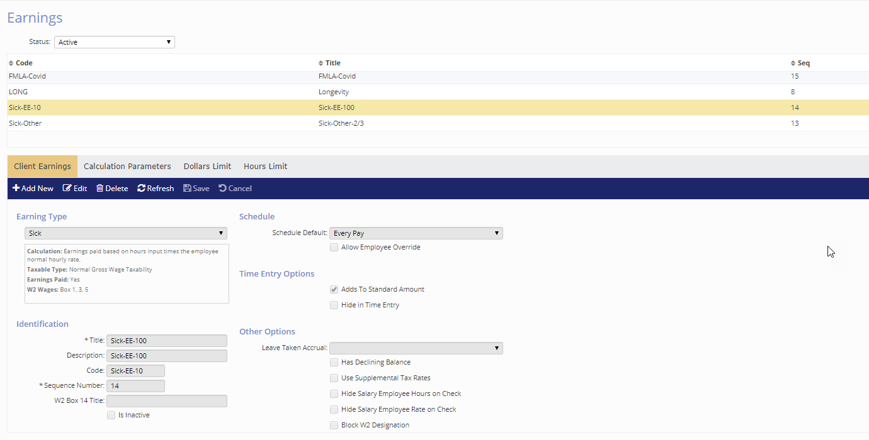
FAQS
Emergency Paid Sick Leave Act
Recommended approach in iSolved for handling the Emergency Paid Sick Leave Act for current Time clients and Non-Time clients
Create a New Accrual Type
Sick-COVID
Create 2 New Accrual Plans
Sick-COVID-FT – 80 Hours
Sick-COVID-PT – client will determine how many hours to load into beginning balance. Average hours for a 2-week period
Set-up 2 new earnings codes
Sick-EE-100 – Used for Leave – Employee’s own care
Sick-Other-2/3 – Used for Leave – Care of another person – will calculate 66.67% of regular rate of pay

Slide 29
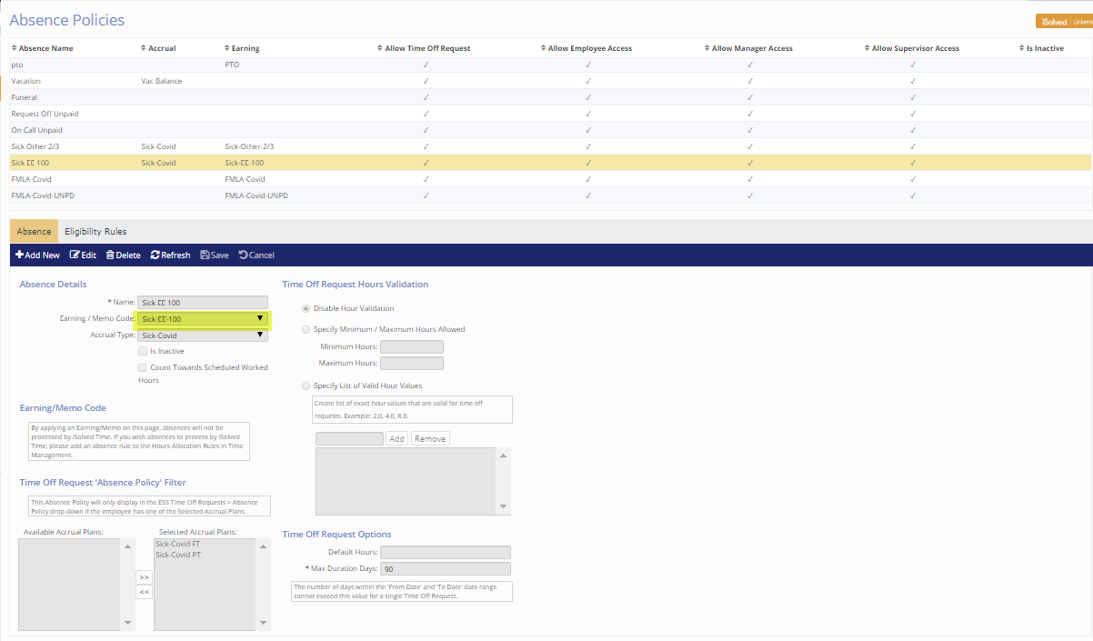
FAQS
Set-up 2 new Absence Polices
Sick EE 100
Sick Other 2/3
Only difference for Time customer is that the earning code won’t be attached to the Absence Policy – we will create an Hours Allocation Rule to map the absence to the earning code.

Slide 30
FAQS
Assign Accrual Plan to Employees
Sick-Covid-FT
Sick-Covid-PT

Slide 31
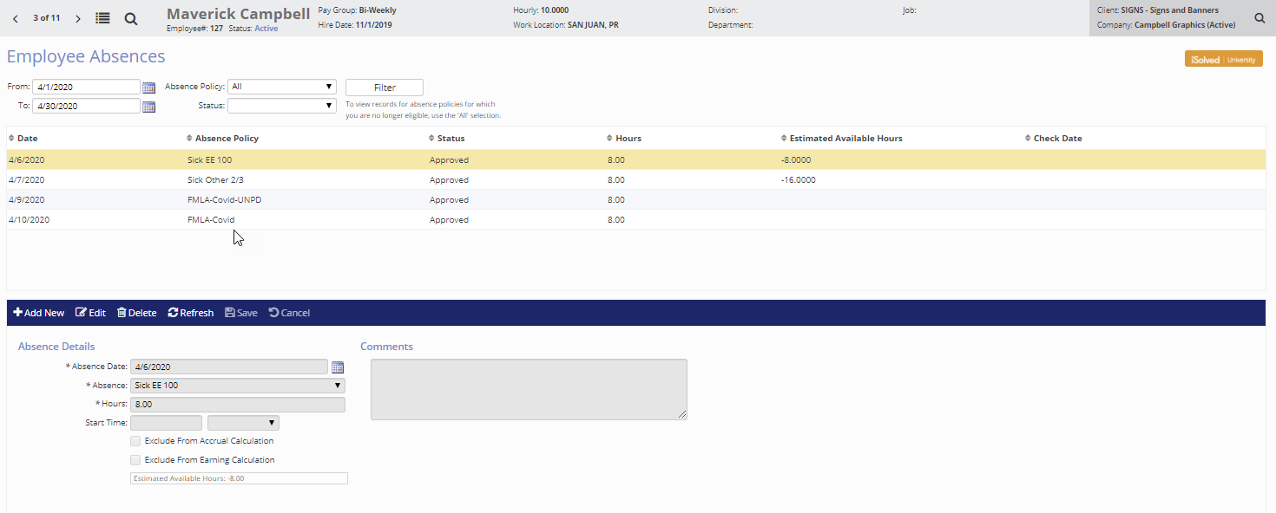
FAQS
→ Enter Absences for Employee
Sick EE 100
Sick Other 2/3

Slide 32
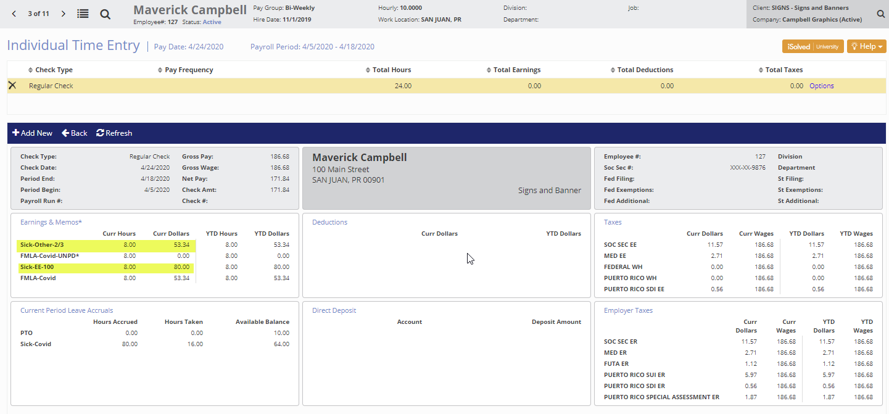
FAQS
EMPLOYEE PAYCHECK

Slide 33
FAQS
Q: If we are offering or instituting a remote work policy, is there a way to have our employees punch in and out from home?
A: Absolutely! To set this up, contact your time support representative, Darlene Booher @ ctrhcmsupport-darlene.ctrhcm.com@email.autotask.net

Slide 34
FAQS
Q: We have integrated COBRA with Infinisource COBRA, how will this work with a lay-off?
A1: If employment is terminated due to a layoff, the termination process in iSolved will remain the same – it would be recommended to use a termination reason of layoff – if you don’t have this termination reason, it can be created for you.
A2: If the layoff is temporary and employees will be put into a layoff status, you will need to determine the following:
Will benefits remain active during the layoff? If so, for how long?
Will benefits end upon moving to layoff status?
If benefits will end, COBRA will need to be processed using the “life event” feature in iSolved
For assistance on COBRA related questions or processes, please contact
Tracey Frazier(tracey.frazier@ctrhcm.com) or
Tara Severin (tara.severin@ctrhcm.com)
Best Practice Guideline: Reduction in Hours Cobra Qualifying Event

Slide 35
WE’RE IN THIS TOGETHER!
We Remain Committed to Partnership
Our team meets daily to review the latest updates in order to assist our clients. We realize that you are drinking from a “firehose” of information. In order to give our clients easy access to information, we will be providing all customers FREE access to our HR Support Center. Our HR Support Center is a great tool that provides you with the latest legislative updates regarding the Coronavirus, sample policies, checklists, and other useful compliance information. Please email supportlog@ctrhcm.com if you would like to receive a login to this useful resource.

Slide 36
EMPLOYER CHECKLIST
Identify coordinator
Educate and empower management
Determine remote work capability and required resources
Have plans in place
Alter/create policy as needed
Maintain consistency, while handling issues case-by-case
Stay updated via HRSupportCenter and/or legal counsel
Communicate, communicate, communicate!

Slide 37
WEBINARS TO COME
Using Employee Messages and Mass Email Utility to
Comply with Paid Sick Leave Communication Requirements
Tuesday 3/24 @ 1pm
Register Here
In addition, we will be adding more webinars to the Events Calendar including a COVD Legal Counsel/Legal Service Options with Attorney Valerie Faeth. We will host this webinar next week. Please get your questions to training@ctrhcm.com so she can address those.
In the interim, please reach out to your support representative with any questions or concerns.

Slide 38
As requirements change and laws are passed,
we will update you as soon as possible.

