Slide 1
USING iSolved to comply with the new ffcra requirements

Slide 2
TODAY’s WEBINAR
Some Housekeeping Items:
All participants have been placed on mute.
All registrants will receive a follow up e-mail with a link to the recorded webinar and any training documentation.
This training is intended for educational and informational purposes. We hope that you will learn a lot today but the information should not be construed as legal advice.
If you have any questions or want to request training, please e-mail training@ctrhcm.com
Today’s Presenters:
Kara Stivason, CTR Trainer & Margie Hayden, CTR Customer Support Manager

Slide 3
AGENDA
H.R 6201(FFCRA) Recap
(if you attended Tuesday’s webinar, this will be a repeat/review for you but bear with us as most of those on today’s webinar did not see this.)
Earning Codes & Tracking
CTR Prep
Your Part

Slide 4
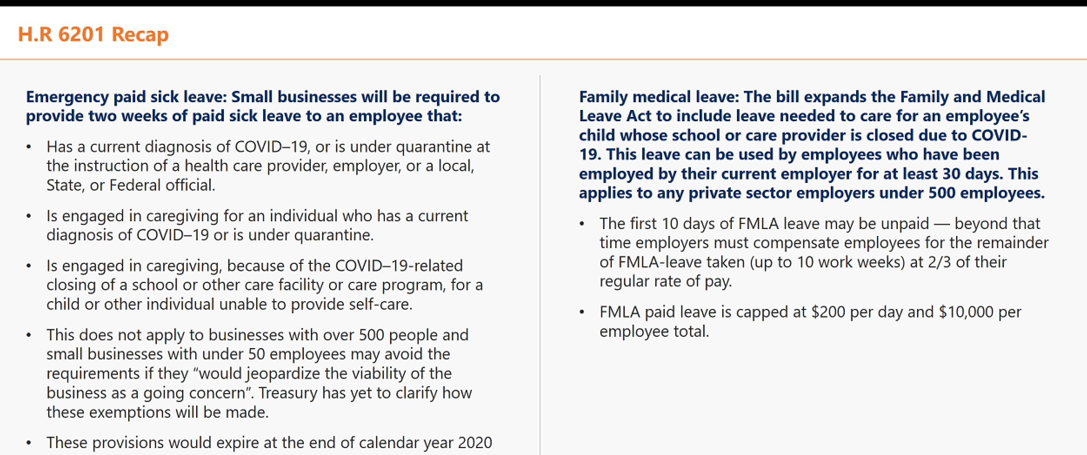
h.R 6201 recap

Slide 5
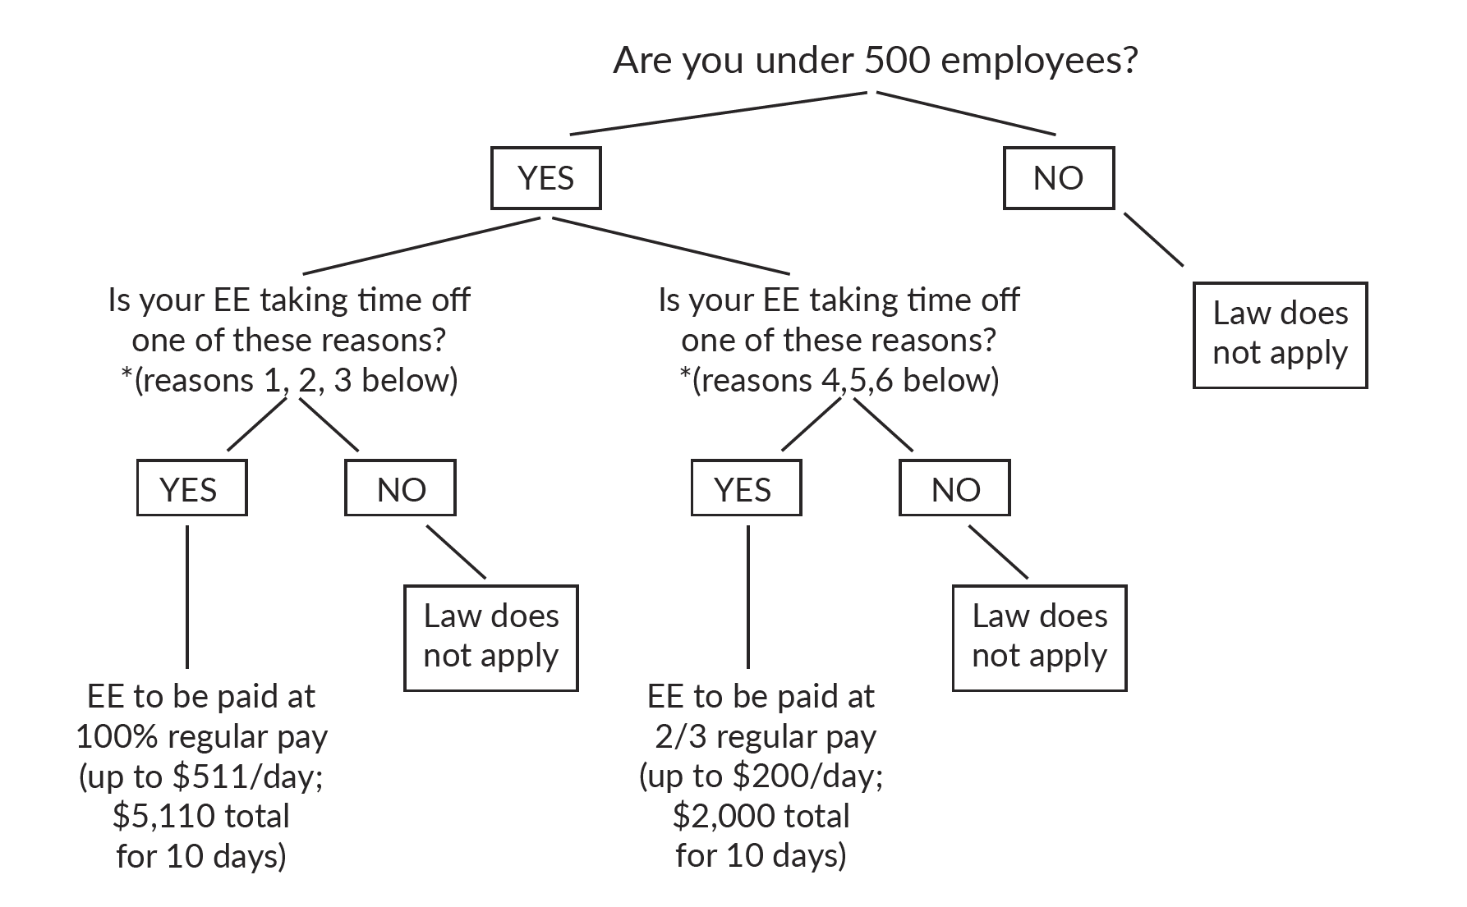
Emergency paid sick leave act

Slide 6
Emergency paid sick leave act
In General.—An employer shall provide to each employee employed by the employer paid sick time to the extent that the employee is unable to work (or telework) due to a need for leave because:
(1) The employee is subject to a Federal, State, or local quarantine or isolation order related to COVID–19.
(2) The employee has been advised by a health care provider to self-quarantine due to concerns related to COVID–19.
(3) The employee is experiencing symptoms of COVID–19 and seeking a medical diagnosis.
(4) The employee is caring for an individual who is subject to an order as described in subparagraph (1) or has been advised as described in paragraph (2).
(5) The employee is caring for a son or daughter of such employee if the school or place of care of the son or daughter has been closed, or the childcare provider of such son or daughter is unavailable, due to COVID–19 precautions.
(6) The employee is experiencing any other substantially similar condition speciﬁed by the Secretary of Health and Human Services in consultation with the Secretary of the Treasury and the Secretary of Labor.

Slide 7
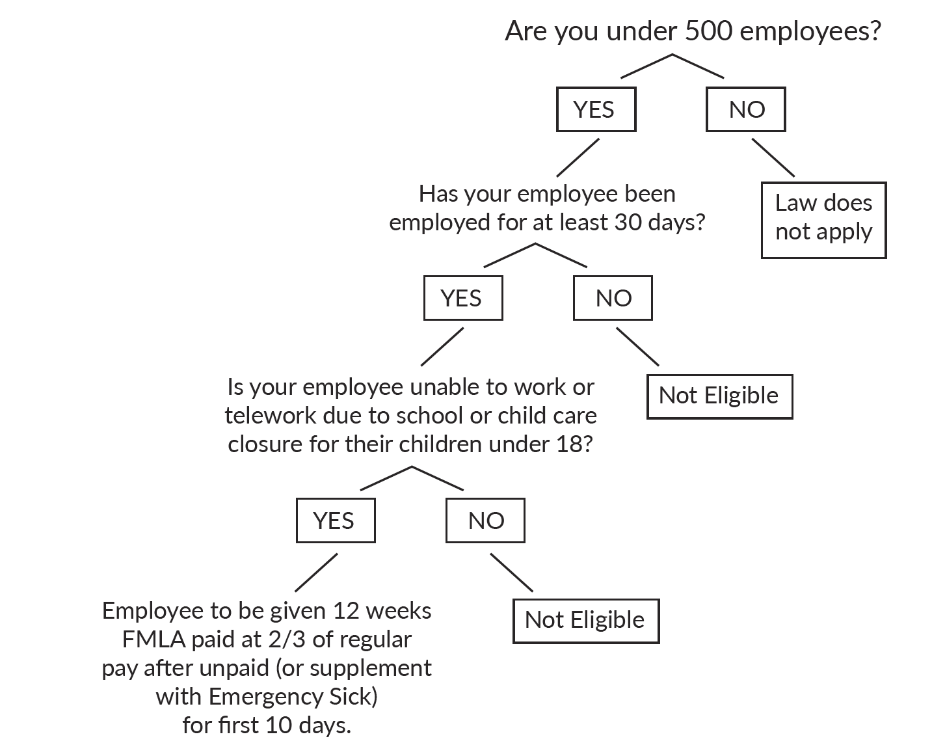
EMERGENCY FAMILY & MEDICAL LEAVE EXPANSION

Slide 8
TRACKING
The DOL (Department of Labor) just issued an announcement that the FFCRA Leaves do not go into effect until APRIL 1.
As such, any leave tracked now through April1st would still be under your existing leave policy, under the old FMLA qualifications, or it must be unpaid.
Let’s talk about how we are going to track starting APRIL 1!

Slide 10
TRACKING
CTR has set up the earning codes and tested these codes in our demo environment and we are ready to set this up in your environment to help you track these leaves.
Let’s learn about how all of this will work in iSolved…

Slide 11
NEW EARNING CODES & Definitions
The legislation defines the Emergency Paid Sick Leave by the type of occurrence and the status of the employee. Full-time employees would be entitled to 80 hours of paid leave.
The legislation requires employers to provide full-time employees with 80 hours of emergency paid “sick” leave related to the coronavirus (with special rules for part-time employees). The paid sick leave could be used in any of the following circumstances:
100% of Pay – Full-time Employees
The employee is subject to a federal, state or local quarantine or isolation order related
to COVID-19.
The employee has been advised by a healthcare provider to self-quarantine due to
concerns related to COVID-19.
The employee is experiencing symptoms of COVID-19 and seeking a medical diagnosis.
The Earning Code used for this is: CovSick-EE-100.

Slide 12
Entering Hours for Emergency Sick Leave Act
The COVSick-EE-100 earning code has been set-up to allow you to enter the sick leave hours in the Time Entry Grid or ITE (Individual Time Entry). Based on the legislation, this earning code has a limit of 80 hours and a dollar limit of $5,110.00 built in.
Let’s see how this will look on the Time Entry Grid and how it will look for the employee on their paycheck…

Slide 13
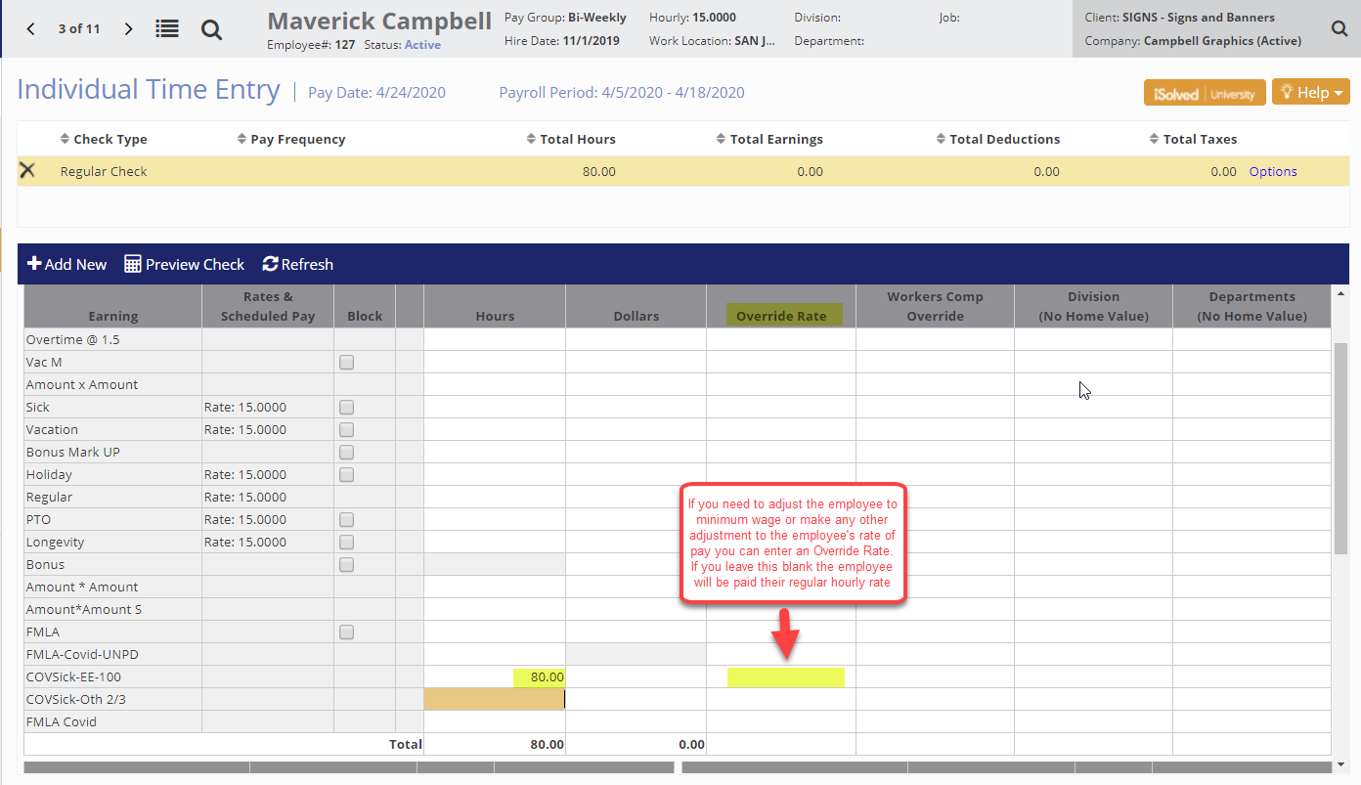
Entering COVSick-EE-100 Earning Code

Slide 14
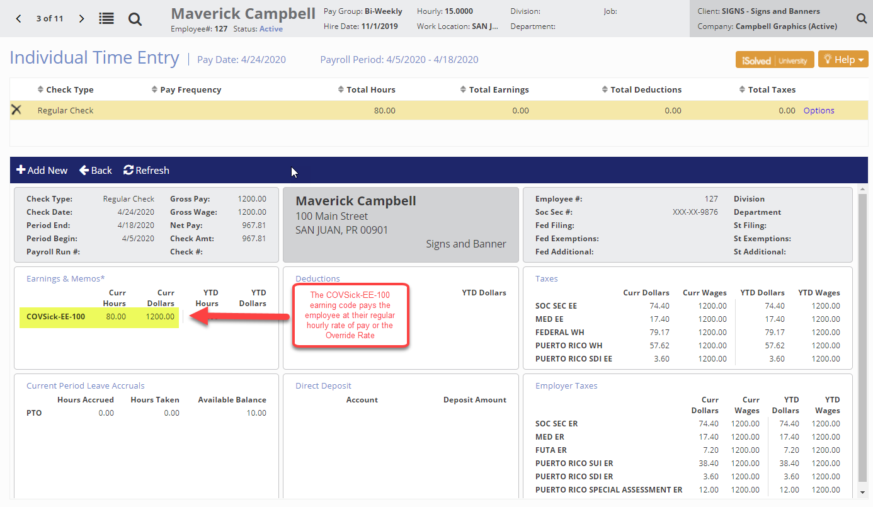
Earning Code COVSick-EE-100 on Employee Paycheck

Slide 15
NEW EARNING CODES & Definitions
2/3 of Pay – Full-Time Employees
2. The employee is caring for an individual who:
Is subject to a federal, state or local quarantine or isolation order related to COVID-19,
or
Has been advised by a health care provider to self-quarantine due to concerns related to COVID-19.
The employee is caring for a son or daughter where the school or place of care of the son or daughter has been closed or the childcare provider of such son or daughter is unavailable due to COVID-19 precautions.
The earning code used for this is COVSick-Oth-2/3

Slide 16
NEW EARNING CODES & Definitions
COVSick-Oth-2/3 earning code has been set-up to allow you to enter the sick leave hours in the Time Entry Grid or ITE. This earning code has a limit of 80 hours and a dollar limit of $2,000.00 built in.
Let’s see how this will look on the Time Entry Grid and how it will look for the employee on their paycheck…

Slide 17
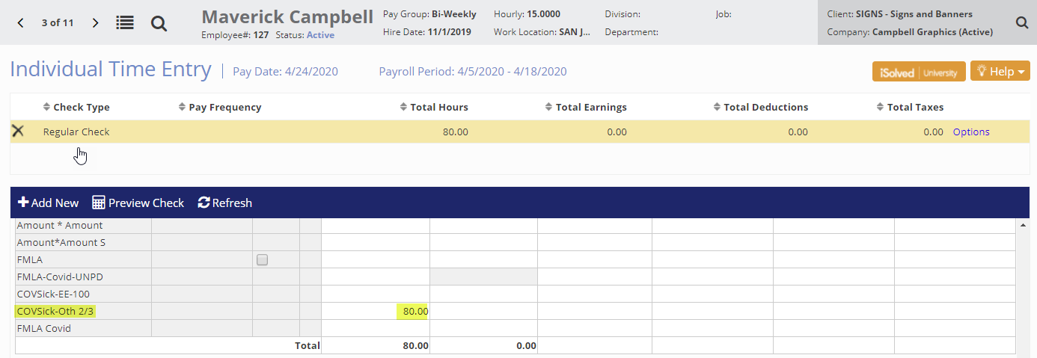
Entering COVSick-Oth-2/3 for Emergency Sick Leave Act

Slide 18
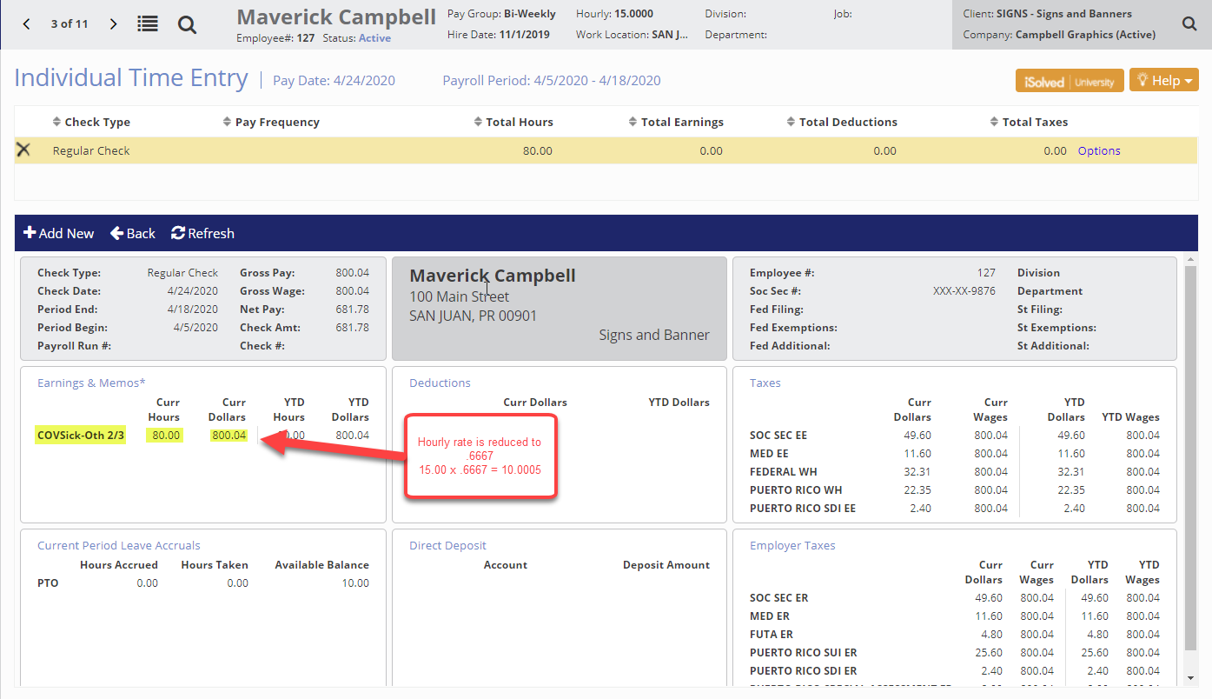
Earning Code COVSick-Oth-2/3 on Employee Paycheck

Slide 19
NEW EARNING CODES & Definitions
Part-Time Employees
3. Part-time employees are entitled to “a number of hours equal to the number of hours that such employee works on average, over a 2-week period.” The paid circumstances are the same for Full Time employees.
A Report Writer report could be used to determine average hours for part time employees.
Leave Employee’s Own Care-100% pay
The earning code used for this is COVSick-EE-100

Slide 20
NEW EARNING CODES & Definitions
The COVSick-EE-100 earning code has been set-up to allow you to enter the sick leave hours in the Time Entry Grid or ITE. This earning code has the ability for you to enter an override to the Annual Hours Limit to reflect the average hours for the part time employee and a dollar limit of $5,110.00 built in.
Let’s see how this looks in iSolved

Slide 21
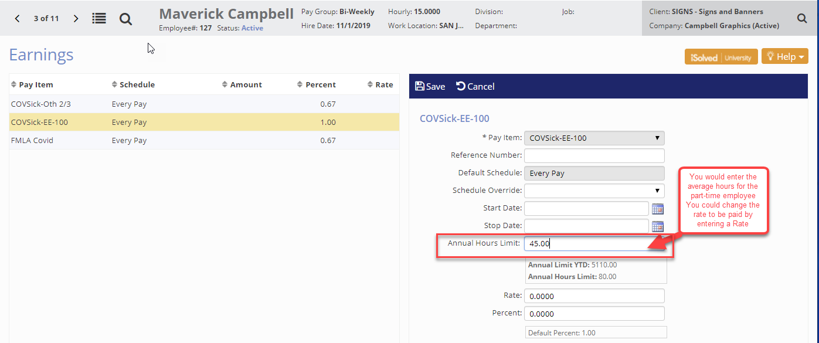
Earning Code COVSick-EE-100 as an Override
To enter the Override, you would navigate to the Employee Management > Employee Pay > Earnings screen for the employee.

Slide 22
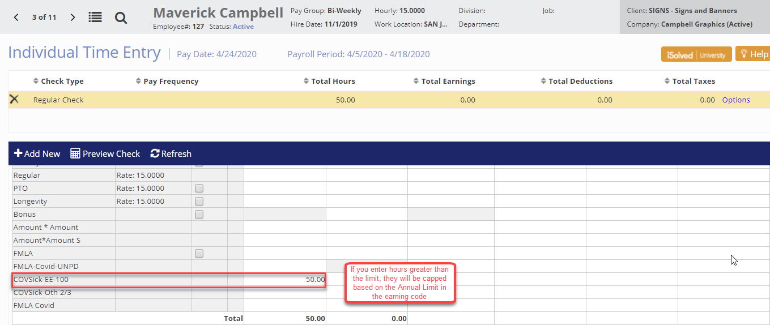
Entering COVSick-EE-100 for Emergency Sick Leave Act

Slide 23
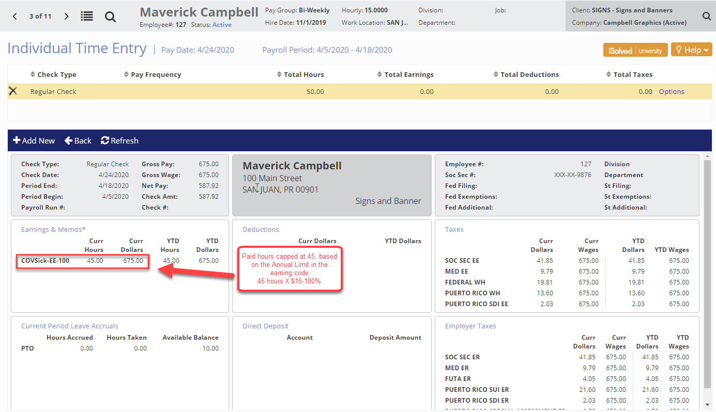
Earning Code COVSick-EE-100 on Employee Paycheck

Slide 24
NEW EARNING CODES & Definitions
Leave Caring for another person-2/3 pay
The COVSick-Oth-2/3 earning code has been set-up to allow you to enter the sick leave hours in the Time Entry Grid or ITE. This earning code has the ability for you to enter an override to the Annual Hours Limit to reflect the average hours for the part time employee and a dollar limit of $5,110.00 built in.
Let’s see how this looks in iSolved

Slide 25
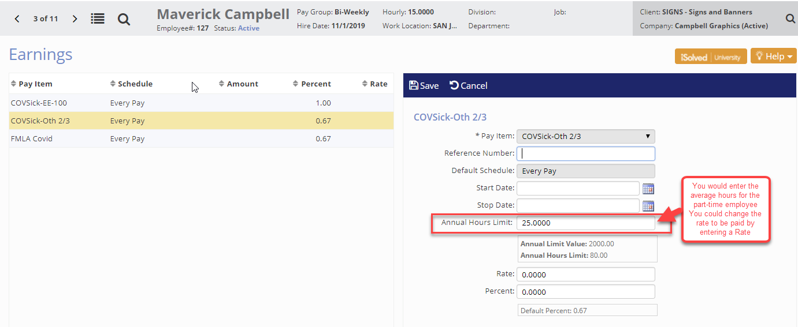
Earning Code COVSick-Oth-2/3 as an Override
To enter the Override, you would navigate to the Employee Management > Employee Pay > Earnings screen for the employee.

Slide 26
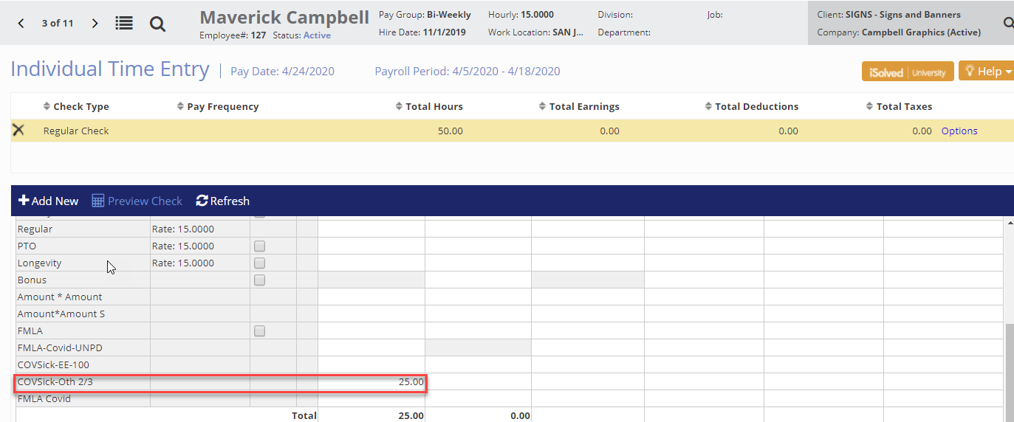
Entering COVSick-Oth-2/3 for Emergency Sick Leave Act

Slide 27
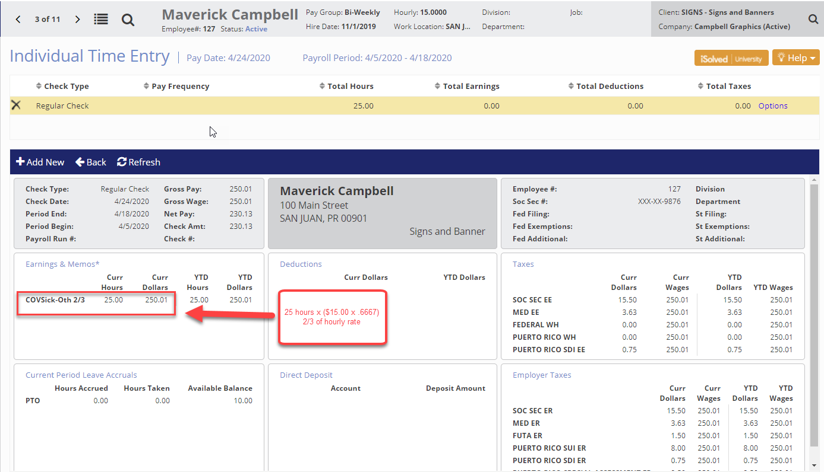
Earning Code COVSick-Oth-2/3 on Employee Paycheck

Slide 28
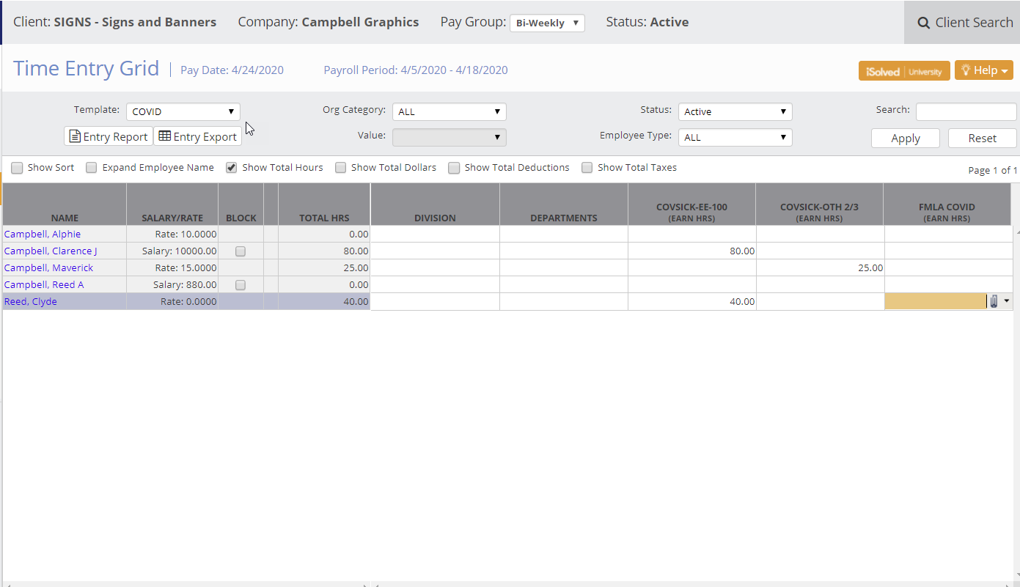
Using the Time Entry Grid instead of ITE
We can also assist you with creating a Time Import file in Excel and the hours can be imported from a spreadsheet.

Slide 29
Entering Absences and Hours - Emergency Family and Medical Leave Expansion Act – FMLA
The legislation defines the Temporary FMLA requirements for any affected by COVID-19 as:
The legislation would require employers with fewer than 500 employees to provide up to 12 weeks of job-protected leave, ten weeks of which would be paid.
Leave would be for “qualifying need related to a public health emergency.”
Qualifying need is defined as to mean “the employee is unable to work (or telework) due to a need for leave to care for the son or daughter under 18 years of age of such employee if the school [meaning a primary or secondary school only] or place of care has been closed, or the child care provider of such son or daughter is unavailable, due to a public health emergency.”
A “public health emergency” is then defined to mean “an emergency with respect to COVID-19 declared by a Federal, State, or local authority.”
The leave applies to employees who have been employed for at least 30 calendar days, rather than the 12-month period under the current FMLA.
The first 10 days for which an employee takes leave could be unpaid leave, or the employee could choose to substitute any accrued vacation, personal or sick leave (including in certain instances the emergency paid “sick” leave described below).
After the initial 10 days, the employer would be required to provide paid leave based on an amount that is not less than two-thirds of an employee’s regular rate of pay and the number of hours the employee would otherwise be normally scheduled to work.

Slide 30
The FMLA COVID earning code has been set-up to allow you to enter the FMLA Covid leave hours in the Time Entry Grid, ITE or as absences if you are using Time. The hourly rate of pay is calculated at 2/3 (.6667). This earning code has the ability for you to enter an override to the hourly rate at the employee level if you needed and has an aggregate limit of $10,000 built in. We can work with you set-up the absence policy to track the FMLA – reach out to your Support Representative.

Slide 31
Entering FMLA COVID
The FMLA COVID earning code has been set-up to allow you to enter the FMLA Covid leave hours in the Time Entry Grid, ITE or as absences if you are using Time. The hourly rate of pay is calculated at 2/3 (.6667). This earning code has the ability for you to enter an override to the hourly rate at the employee level if you needed and has an aggregate limit of $10,000 built in. We can work with you set-up the absence policy to track the FMLA – reach out to your Support Representative.

Slide 32
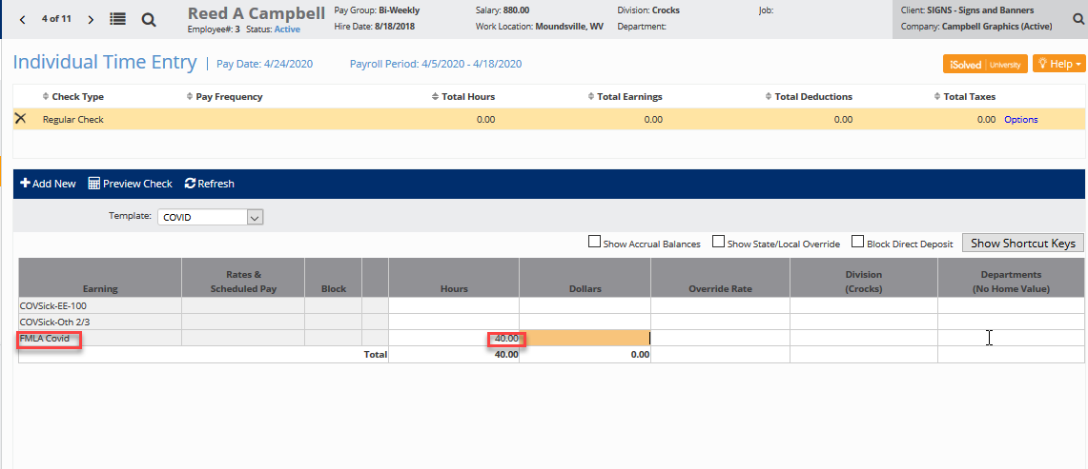
Entering FMLA COVID for on the ITE

Slide 33
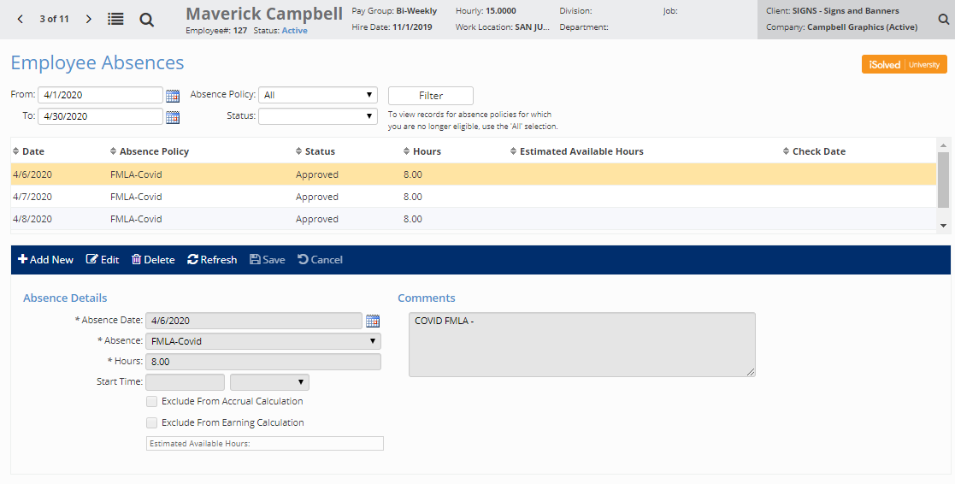
Absences
Example of entering the employee absences using the absence code – FMLA-COVID.

Slide 34
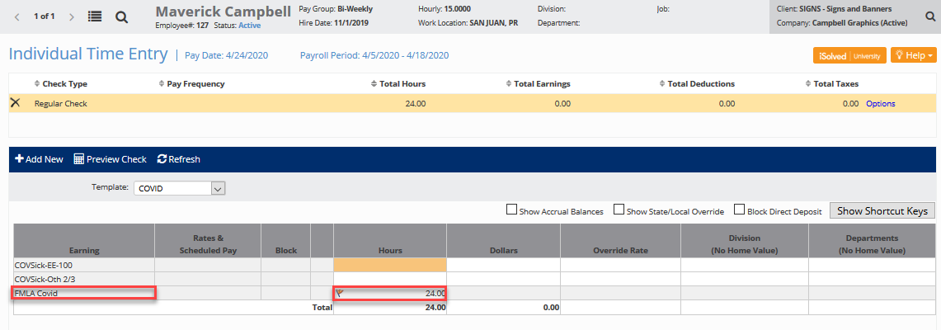
Here is what the employee’s paycheck looks like

Slide 35
CTR is committed to giving you REAL-LIFE, REAL-TIME answers. We know there is an abundance of resources out there and while we want to provide updated information to you, it’s important we are constantly giving you answers to the ones you need the most.

Slide 36
VISIT OUR COVID-19 Information Center where we are providing answers to your questions, keeping you updated and posting our webinars-click here.
Upcoming Webinars (to register, visit our COVID-19 Information Center)
COVID-19: Our Most Pressing Legal Questions Answered: In this webinar, CTR will be joined by Special Guest Speaker, Attorney Valerie Faeth. Together, we will review the answers to the most-pressing legal questions we have received. To learn more about our guest speaker, please click here.
COVID-19: Our Most Pressing HR Questions Answered: In this webinar, CTR will be joined by Special Guest Speaker, AcuityHR President Bob Floerak. Together we will review the answers to the most-pressing HR questions we have received. To learn more about our guest speaker, please click here.

